Slide 1
AWS Auto Scaling
What is Auto Scaling
Features of AWS Auto Scaling
EC2 Auto Scaling
Getting started with EC2 Auto Scaling
Auto Scaling Components
Auto Scaling Groups – Scaling Policies

Slide 2
What is Auto Scaling
AWS Auto Scaling enables you to configure automatic scaling for the scalable resources
You can configure automatic scaling for individual resources or for whole applications.
With AWS Auto Scaling, you configure and manage scaling for your resources through a scaling plan.
The scaling plan uses dynamic scaling and predictive scaling to automatically scale your application's resources.
The scaling plan lets you choose scaling strategies to define how to optimize your resource utilization.
You can optimize for availability, for cost, or a balance of both.

Slide 3
Features of AWS Auto Scaling
Amazon EC2 Auto Scaling groups
Launch or terminate EC2 instances in an Auto Scaling group.
Amazon EC2 Spot Fleet requests:
Launch or terminate instances from a Spot Fleet request, or automatically replace instances that get interrupted for price or capacity reasons.
Amazon ECS
Adjust the ECS service desired count up or down in response to load variations.
Amazon DynamoDB
Enable a DynamoDB table or a global secondary index to increase or decrease its provisioned read and write capacity to handle increases in traffic without throttling.
Amazon Aurora
Dynamically adjust the number of Aurora read replicas provisioned for an Aurora DB cluster to handle changes in active connections or workload.

Slide 4
EC2 Auto Scaling
Auto Scaling allows your AWS compute needs (EC2 instances) to grow or shrink depending on your workload requirements
Auto scaling ensures that you have the right number of AWS EC2 instances for your needs at all times
Auto Scaling helps you save cost by cutting down the number of EC2 instances when not needed, and scaling out to add more instances only when it is required

Slide 5
Getting started with EC2 Auto Scaling
How many Availability Zones the Auto Scaling group should span.
What existing resources can be used, such as security groups or Amazon Machine Images (AMIs).
Whether you want to scale to increase or decrease capacity?
What metrics have the most relevance to your application's performance.
How long it takes to launch and configure a server.

Slide 6
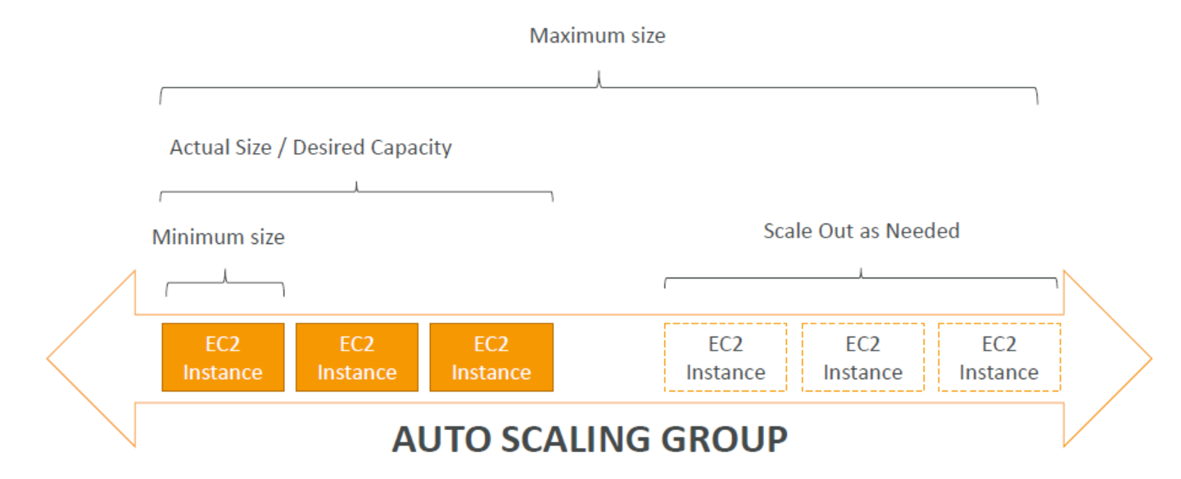
The goal of an Auto Scaling Group (ASG) is to:
Scale out (add EC2 instances) to match an increased load
Scale in (remove EC2 instances) to match a decreased load
Ensure we have a minimum and a maximum number of machines running
Automatically Register new instances to a load balancer

Slide 7
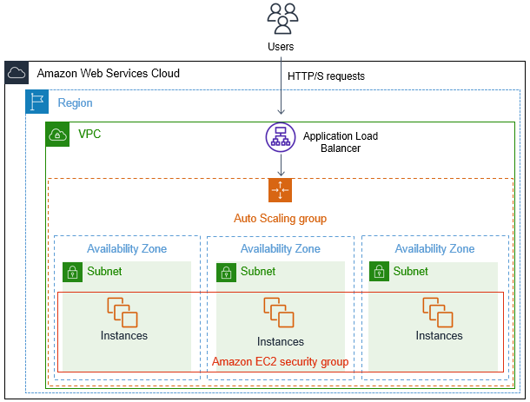

Slide 8
Auto Scaling Components
Launch Configuration:
Is the configuration template used to create new EC2 instances for the ASG, defines parameters like:
Instance family, instance type, AMI, Key pair, Block devices, and Sec groups are parameters defined in the launch configuration
Auto Scaling Group:
Min Size / Max Size / Initial Capacity
Network + Subnets Information
Load Balancer Information
Scaling Policies
Is a logical grouping of EC2 instances
Scaling Policy
Determines when and how the ASG scales or shrinks
On-demand/Dynamic scaling
Cyclic/Scheduled scaling

Slide 9
Scaling options
Several ways to scale the Auto Scaling group
Manual scaling
Attach/detach ec2 instances manually
Dynamic scaling
Scaling policy added for dynamic scaling
Predictive scaling
Scaling actions are performed automatically as per the time and date set
Scheduled scaling
Can scale EC2 instances in your Auto Scaling group in advance of daily and weekly patterns

Slide 10
Dynamic Scaling– Scaling Policies
Define a scaling policy that dynamically resizes your Auto Scaling group to meet changes in demand
Dynamic scaling policies use real-time data to scale your group based on configurable metrics
Target Tracking Scaling
Most simple and easy to set-up
Example: I want the average ASG CPU to stay at around 40%
Simple / Step Scaling
When a CloudWatch alarm is triggered (example CPU > 70%), then add 2 units
When a CloudWatch alarm is triggered (example CPU < 30%), then remove 1
Scheduled Actions
Anticipate a scaling based on known usage patterns
Example: increase the min capacity to 10 at 5 pm on Fridays

Slide 11
Predictive scaling
Can scale EC2 instances in your ASG in advance of daily and weekly patterns
Predictive scaling policies use historical data to scale out your group ahead of forecasted hourly load.
Predictive scaling suited for
Cyclical traffic, such as high use of resources during regular business hours and low use of resources during evenings and weekends
Predictive scaling uses machine learning to predict capacity requirements based on historical data from CloudWatch.

